Slide 1
LECTURE I
Introduction to Database Management System
MISD

Slide 2
Objectives
Manual filling systems and their challenges
Characteristics of file based systems and their challenges
Why database approach?
Terminologies
Types of DBMS
Functions of a DBMS and its major components.
Advantages and disadvantages of DBMS’s
Roles/ Personnel in the database approach
MISD

Slide 3
INTRODUCTION TO DATABASE
What is a database?
A structured collection of logically related data. A database is a collection of related information which allow you to insert, delete, update, retrieve data.
Databases can store information about people, products, orders, or anything else .
Data: This is a collection of facts made up of text, numbers and dates. E.g Alex csc 1100 97
Information: It refers to the meaning given to data in the way it is interpreted. E.g Alex is a student whose marks for Computer Literacy are 97 and whose course code is csc 1100.
MISD

Slide 4
Qualities of Valuable Information
• Accurate. Accurate information is correct information. Inaccurate information often is worse than no information, because inaccurate information can lead to wrong decisions.
• Verifiable. Information can be confirmed. In other words, the accuracy of the information can be verified.
• Timely. Information has an age suited to its uses. Although most information loses its value with time,
some information, such as information on trends, gains value as time passes and more information obtained.
• Organized. Information should be arranged to suit the needs and requirements of the user.
• Meaningful. Information should be relevant to the person who receives it. Because certain information is
meaningful only to specific individuals or groups, unnecessary information should be eliminated.
• Cost-effective. The cost of producing the resulting information should be less than the value of the information.
MISD

Slide 5
Database functionality/Importance
Manages large amounts of data
A database stores and manages a large amount of data on a daily basis. This would not be possible using any other tool such as a spreadsheet as they would simply not work.
Accurate
A database is pretty accurate as it has all sorts of build in constraints, checks etc. This means that the information available in a database is guaranteed to be correct in most cases.
Easy to update data
In a database, it is easy to update data using various Data Manipulation languages (DML) available. One of these languages is SQL.
Security of data
Databases have various methods to ensure security of data. There are user logins required before accessing a database and various access specifiers. These allow only Authorised users to access the database.
Data integrity
This is ensured in databases by using various constraints for data. Data integrity in databases makes sure that the data is accurate and consistent in a database.
Easy to search data
It is very easy to access and search data in a database. This is done using Data Query Languages (DQL) which allow searching of any data in the database and performing computations on it.
MISD

Slide 6
Features of a Database
Data insertion
Update of a database. Edit existing data in the database, such as changing the current location of an item.
Deletion of information, perhaps if an item is sold or discarded.
Organize and view the data in different ways.
Data storage for future reference.
Data retrieval from the database using a query.
Rich set of different data types to accommodate any kind of data to be inserted.
Import/Export data between databases and applications. Share data between two or more databases or from other applications such as Word processor, Spread sheet, Presentation etc.
Permissions and access. Maintain control over your data by using permission-based access. Manage and assign privileges to add, delete, update, store data.
MISD

Slide 7
Database Architecture
What is Database Architecture?
A Database Architecture is a representation of DBMS design. It helps to design, develop, implement, and maintain the database management system.
A DBMS architecture allows dividing the database system into individual components that can be independently modified, changed, replaced, and altered. It also helps to understand the components of a database.
MISD

Slide 8
Types of DBMS Architecture
There are mainly three types of DBMS architecture:
One Tier Architecture (Single Tier Architecture)
Two Tier Architecture
Three Tier Architecture
1-Tier Architecture
In this architecture, the database is directly available to the user. It means the user can directly sit on the DBMS and uses it.
Any changes done here will directly be done on the database itself. It doesn't provide a handy tool for end users.
The 1-Tier architecture is used for development of the local application, where programmers can directly communicate with the database for the quick response.
MISD

Slide 9
Types of DBMS Architecture
2-Tier Architecture
The 2-Tier architecture is same as basic client-server. In the two-tier architecture, applications on the client end can directly communicate with the database at the server side. For this interaction, API's like: ODBC, JDBC are used.
The user interfaces and application programs are run on the client-side.
The server side is responsible to provide the functionalities like: query processing and transaction management.
To communicate with the DBMS, client-side application establishes a connection with the server side.
MISD

Slide 10
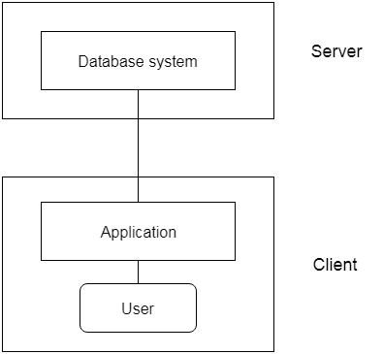
2-Tier Architecture
MISD

Slide 11
3-Tier Architecture
The 3-Tier architecture contains another layer between the client and server. In this architecture, client can't directly communicate with the server.
The application on the client-end interacts with an application server which further communicates with the database system.
End user has no idea about the existence of the database beyond the application server. The database also has no idea about any other user beyond the application.
The 3-Tier architecture is used in case of large web application.
MISD

Slide 12
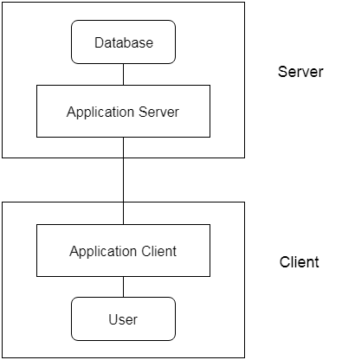
3-Tier Architecture
MISD

Slide 13
Functions of a DBMS
  Data Storage, Retrieval, and Update.
  Authorization Services: A User-Accessible Catalog (rights of the user, database tables)
  Transaction Support
  Concurrency Control Services.
  Recovery Services.
  Support for Data Communication.
  Integrity/reliable Services (maintain something thing in its truth or originality)
  Services to Promote Data Independence.
MISD

Slide 14
Advantages of DBMS
Control of data redundancy; As we discussed TFBS wastes space by storing the same information in more than one file. DBMS help in integrating files and avoiding multiple copies of the same data.
Improved Security. If data is always accessed through the DBMS. The DBMS can enforce integrity constraints e.g. before inserting salary information for an employee, the DBMS can check that the dept budget is not exceeded.
MISD

Slide 15
Advantages Cont’d
Increased concurrency; In some file-based systems, if two or more users are allowed to access the same file simultaneously, the accesses may interfere with one another. With DBMS two or more users can access data at the same time without loss of data integrity.
Improved data accessibility and responsiveness; data crosses departments and unplanned questions can be asked unlike fixed queries in file based systems.
MISD

Slide 16
Advantages cont’d
Improved backup and recovery services; DBMS provides facilities of minimizing amount of processing that is lost following a failure.
Sharing of data. Typically files are owned by the departments that use them . On the other hand the database belongs to the entire organization and can be shared by all authorized users.
MISD

Slide 17
Disadvantages of DBMS
Complexity: It has several components which need serious and careful planning to get a good DBMS.
Size: large size of software taking large disk space and memory.
Cost of DBMS: varies with the number of users 1 or 50
Additional hardware costs: e.g. storage, memory etc
MISD

Slide 18
Disadvantages of DBMS
Cost of conversion; costs of converting existing applications to run on the new DBMS and hardware, employing specialists, training staff etc.
Performance; some applications may not run as first as the used to because DBMS caters for several applications at once.
Higher impact of a failure; integration of resources increases vulnerability.
MISD

Slide 19
Types of Databases
Flat-file database/sequential file
This is a database file that consists of a single data table. This is used to maintain only the simple records e.g list of items
Advantages of using flat-file database
Easy to understand since they contain single data
Easy to implement
Less hardware and software requirements
Less skills are required to handle flat database systems
Best for small databases
MISD

Slide 20
Disadvantages of using flat-file database
Less security since it is easy to extract information
Data inconsistency(data not being uniform)
Data redundancy (same data being repeated)
Sharing of data is a difficult task
Slow for huge data
Searching process is time consuming
MISD

Slide 21
Relational Database
It is a database file one that consists of more than one table and the relationship can be created between tables.
Advantages of using relational database
Easy Data Manipulation i.e. insert, update, delete and select
You can create separate records for each type of data to be stored.
Ability to program a query to search all data tables for the exact data you need.
Ability to scale the database to the size of a very large organization.
Ability to insert, update and share data among many users
It has advanced capabilities for analyzing and reporting
Security. Security control and authorization can be implemented more easily .
MISD

Slide 22
Disadvantages of using relational database
It has complex applications and systems which are very difficult to understand
Once the database is created, it is hard to change
It is time consuming to do data entry
There is need to hire specialized people to create it using complex query languages
There is need to hire a database administrator to maintain the database once it is built.
Costly. It is expensive to both create and maintain
Some relational databases have limits on field lengths. When you design the database, you have to specify the amount of data you can fit into a field.
MISD

Slide 23
Guidelines for Designing Database
A database management system can be a useful tool, but only if you
first carefully design the database so that it meets the needs of its
users. In database design, you determine the fields, tables, and relationships
needed to satisfy the data and processing requirements.
When you design a database, you should follow these guidelines:
• Identify all the fields needed to produce the required
information. The company needs information about customers and orders
• Group related fields into tables. The fields relating to customers are grouped into the Customer table, the other fields are grouped into the Order table.
• Determine each table's primary key. Recall that a primary key uniquely identifies each record in a table. Without a primary key, selecting the exact record you want can be a problem For other tables, two or more fields might be needed to function as the primary key. In these cases, the primary key is referred to as a composite key.
MISD
Notes:
TROPICAL HIGH SCHOOL ICT DEPARTMENT 2014

Slide 24
Guidelines for Designing Database
• Include a common field in related tables. You use the common field to connect one table logically with another table. When you include the primary key from one table as a field in a second table to form a relationship, the field is called a foreign key in the second table.
• Avoid data redundancy. Data redundancy occurs when you store the same data in more than one place. With the exception of common fields to connect tables, you should avoid redundancy because it wastes storage space and can cause inconsistencies.
• Determine the properties of each field. You need to identify the properties of each field so that the DBMS knows how to store, display, and process the field. These properties include the field's name, maximum number of characters or digits, data type, description, valid values, and other field characteristics.
MISD
Notes:
TROPICAL HIGH SCHOOL ICT DEPARTMENT 2014

Slide 25
Advantages of using an electronic database
Organization of data. Data has got different data types so with a database, you group together data with same data type.
Efficient retrieval of data. Instead of going through endless piles of paper files, a database pulls up data with a simple query.
Storage of large volume of data. A database has the capacity of holding big volume of data which can be kept for years without disappearing for future references.
Maintaining the consistency of the data. With a database, one can easily keep data uniform without inserting data which is not expected.
MISD

Slide 26
Advantages of using an electronic database
Eases sharing of data/communication. Large companies can benefit from databases when data must be spread to various branches for access.
Easy decision making. By looking at database records and how data has changed over time, one can keep track of important trends which can make your business more competitive.
Databases are more secure. Databases add another level of security to valuable data. It can be password protected by using different layers of security can be implemented on a given database.
Setting up an off-site station. Not only can a database be stored in a remote facility unaffected by events such as fire, malicious damage or theft.
MISD

Slide 27
Limitations/Disadvantages of using an electronic database
Database systems are complex and time consuming to design. It takes a lot to come up with a database which can be used for some time as it requires expertise during the design phase.
Compatibility issues
In reality it may be difficult to access your database on computers using different software or older versions of the same software. A database designed in ms access 2007 cannot be opened using ms access 2003.
Cost
Though free options exist, the best DBMS are still quite expensive.
MISD

Slide 28
Limitations/Disadvantages of using an electronic database
Internet Requirements
DBMS software often depends on fast Internet connection for optimal use and easy help-menu access; for users without good Internet access, database functionality can be limited.
Frequent Upgrades
While free upgrades for existing software are not a problem for users with good Internet access, whole-version upgrading require frequent new software purchases.
Learning Curve
Though DBMS are user-friendly when it comes to basic functions, advanced functions can take quite a long time to learn so initial training is required for all programmers and system users.
MISD

Slide 29


Manual Filing systems
  A manual file is set up to hold all external and internal correspondence about a given subject e.g. bills, project
MISD

Slide 30


Manual Filing Systems cont’d
  For easy storage, especially as numbers increase, labels are utilized.
  These files are kept in cabinets which are locked to ensure security.
MISD

Slide 31
Manual Filing system cont’d
It works well when the data or number of items to be stored is small.
Works well on a large number of items which only require storage and retrieval.
Retrieval of data; is mainly sequential i.e. search begins from first entry or through an indexing system.
Limited processing of data i.e. answering complex queries that require data from different sources e.g. annual reports about sales was very difficult.
QUIZ: What are the challenges/Limitations of the manual filing system?
MISD

Slide 32
File-based Systems
With a file based approach each user defines and creates with a specific software the files he needs for a specific application.
  Better alternative to paper based filing systems – easy data access and retrieval
A file based system is a collection of application programs that perform services for the user.
Each program within a file based system defines and manages its own data
MISD

Slide 33
How it works?
Accounts
Department
HRM
Department
Production
Department
Accounts
Data
HR
Data
Production
Data
Each department maintain there own set of data. There is no link between those data pools.
MISD

Slide 34
File-based Systems
A file is a collection of records which contain logically related data.
Each Record contains logically connected set of one or more fields, where each field represents some characteristic of a real world object.
For example object student with field/characteristics like regno. Student no. name
MISD

Slide 35
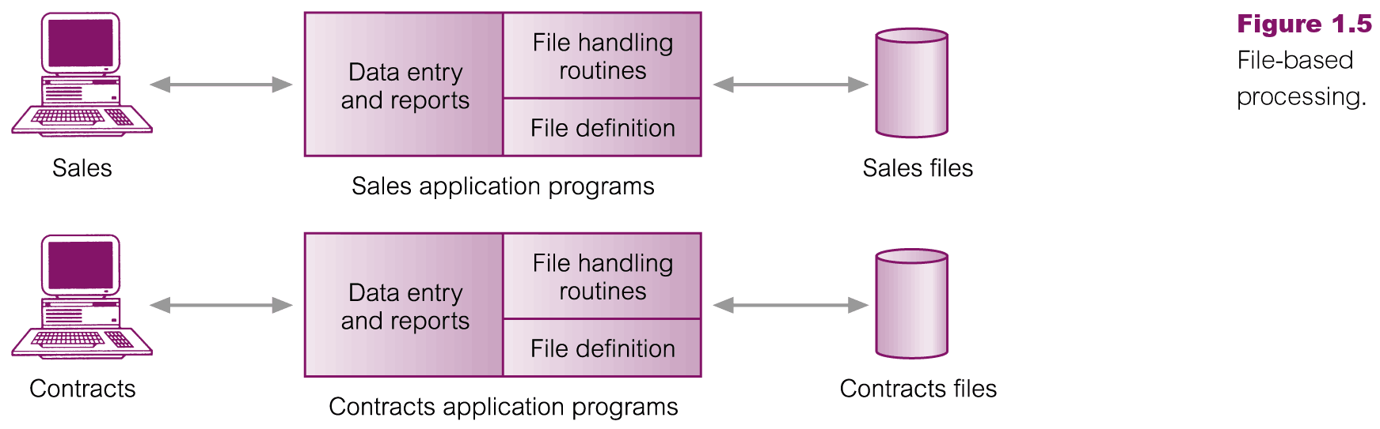
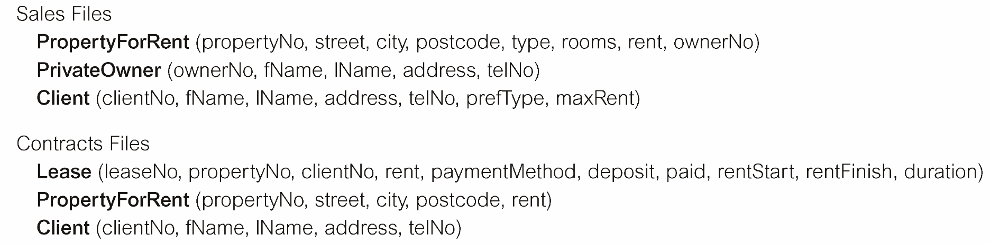
File-Based Processing
MISD

Slide 36
LIMITATIONS OF FILE-BASED APPROACH
In comparison to the database system approach a file based approach results in some limitations:
Separation and isolation of data
  Each program maintains its own set of data.
  Users of one program may be unaware of potentially useful data held by other programs.
Duplication of data
  Same data is held by different programs.
  Wasted space and potentially different values and/or different formats for the same item.
MISD

Slide 37
LIMITATIONS OF FILE-BASED APPROACH
Data dependence
  Unhealthy dependency between data and programs. File structure is defined in the program code.
Incompatible file formats
  Programs are written in different languages, and so cannot easily access each others files.
Fixed Queries/Proliferation of application programs
  Programs are written to satisfy particular functions. Any new requirement needs a new program.
MISD
Notes:
Program data dependence refers to the coupling of data stored in files and the specific programs required to update and maintain those files such that changes in programs require changes to the data. With data dependence, data descriptions are included with the application programs that use the data
In other words application programs are dependent on the how the data is physically stored and accessed

Slide 38
DATABASE APPROACH
A database is defined as a collection of related data, and a description of the data, designed to meet the information needs of an organisation.
Why Databases are important
  Efficient Manipulation of large data sets.
  Integration of Multiple Data Sources
Examples of database applications
  Purchases from the supermarket
  Purchases using your credit card
  Booking a holiday at the travel agents
MISD

Slide 39
Characteristics of the Database approach
Single repository of data
  sharable by multiple users, hence favorable for concurrency control
Self-describing
  System catalogue contains metadata (data defining other data).
  Catalogue contain information about the definitions of the database objects (for example, tables, views)and security information about the type of access that users have to these objects.
  Multiple views of data - to support individual needs of users.
MISD

Slide 40
Characteristics of the Database approach cont’d
Program-data independence
  Data independence is the notion of keeping data separate from all programs that make use of the data.
    Data independence ensures that the data cannot be redefined or reorganized by any of the programs that make use of the data.
    In this approach, the data remains accessible, but is also stable and cannot be corrupted by the applications using it.
  It refers to the immunity of user applications to make changes in the definition and organization of data
MISD

Slide 41
When not to use a Database
Some circumstances which do not require use of databases include:
  If there is a real time constraint to the application availability
  If the speed of the application is critical. Databases are, on average, slow compared to other computer processes.
  If the data involved is small and can easily be organized using other traditional means
  If the application lifespan is small
MISD

Slide 42
Database Terminologies
Database Management System: A software system that enables users to define, create, and maintain the database and which provides controlled access to this database e.g. Oracle 9i /10G, MS Access, SQL server, DB2, MySQL
Database application: A program that interacts with a database by issuing an appropriate request to the DBMS at some point in its execution.
  Database applications access the database, process the data and generate the required information.
Relational DB: A collection of tabular structures that can be related to each other by a common field.
MISD
Notes:
Software that enables you to create a database, to maintain its contents, and to retrieve and display data in reports and forms.

Slide 43
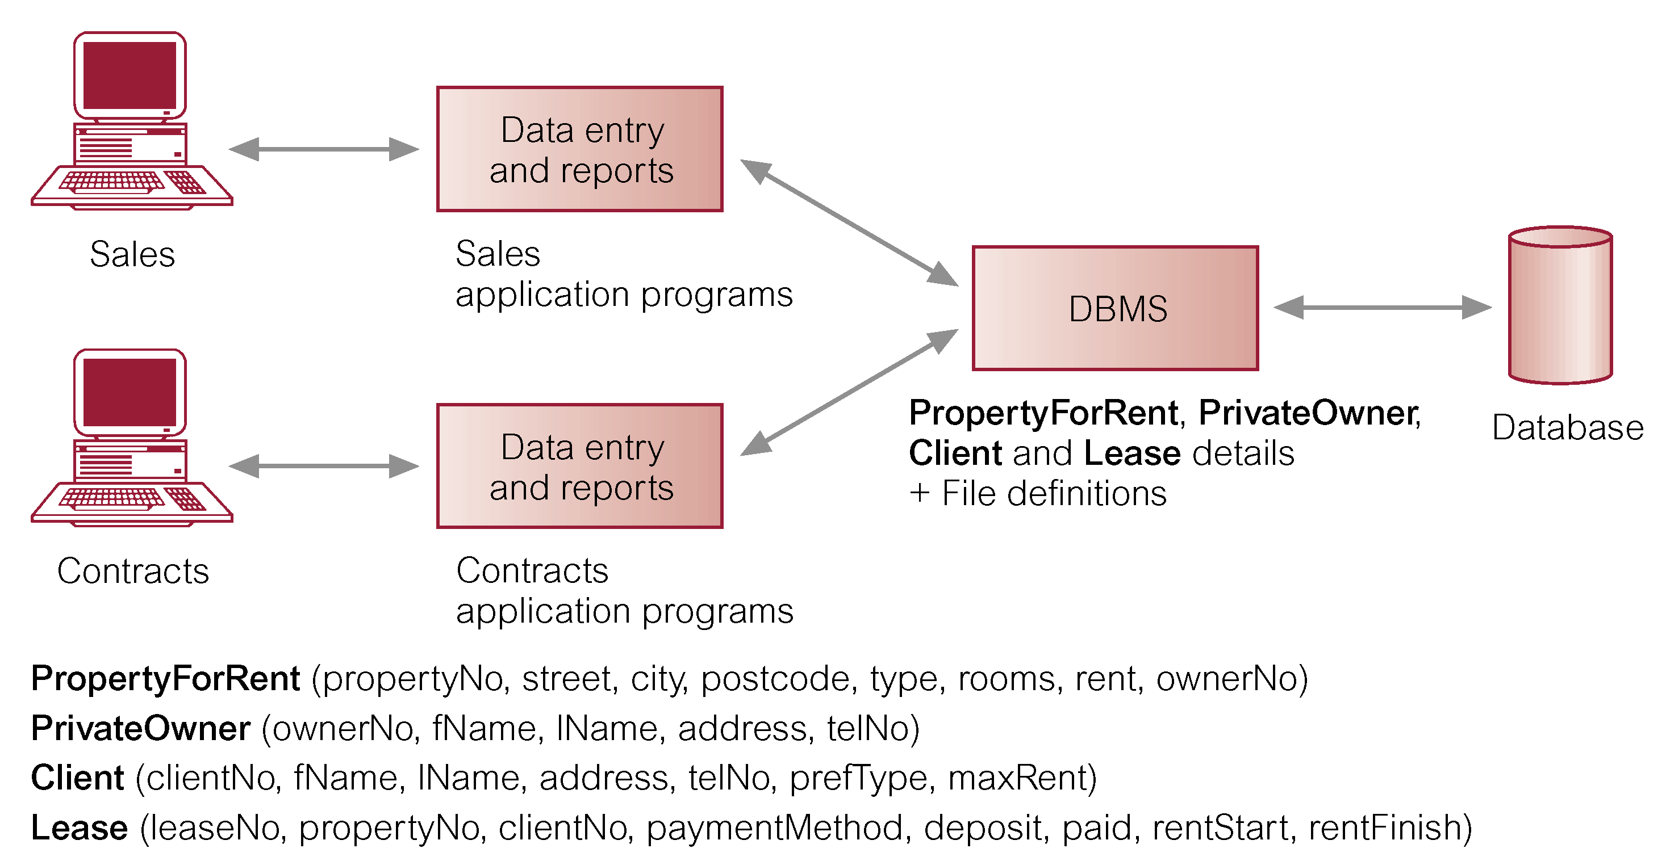
Database Management System (DBMS)
Users
MISD

Slide 44
DBMS: Database Languages
Data definition language (DDL)
  Permits specification of data types, structures and any data constraints that should be part of the database.
  All specifications are stored in the database.
Data manipulation language (DML)
  Enables those with access to the database to insert, update, delete and retrieve data from it.
  Standard Query Language (SQL) is an example of a DML
MISD

Slide 45
Types of DB Management Systems
The number of users determines whether the DBMS is classified as single-use or multi-user.
  A Single –user DBMS supports only one user at a time. In other wards if a user A is using the database, users B and C must await.
  Multi-user DBMS: supports multiple users at the same time The entire organization and supports many users across many departments.
Task: Give examples of single user and multiuser DBMS?
MISD

Slide 46
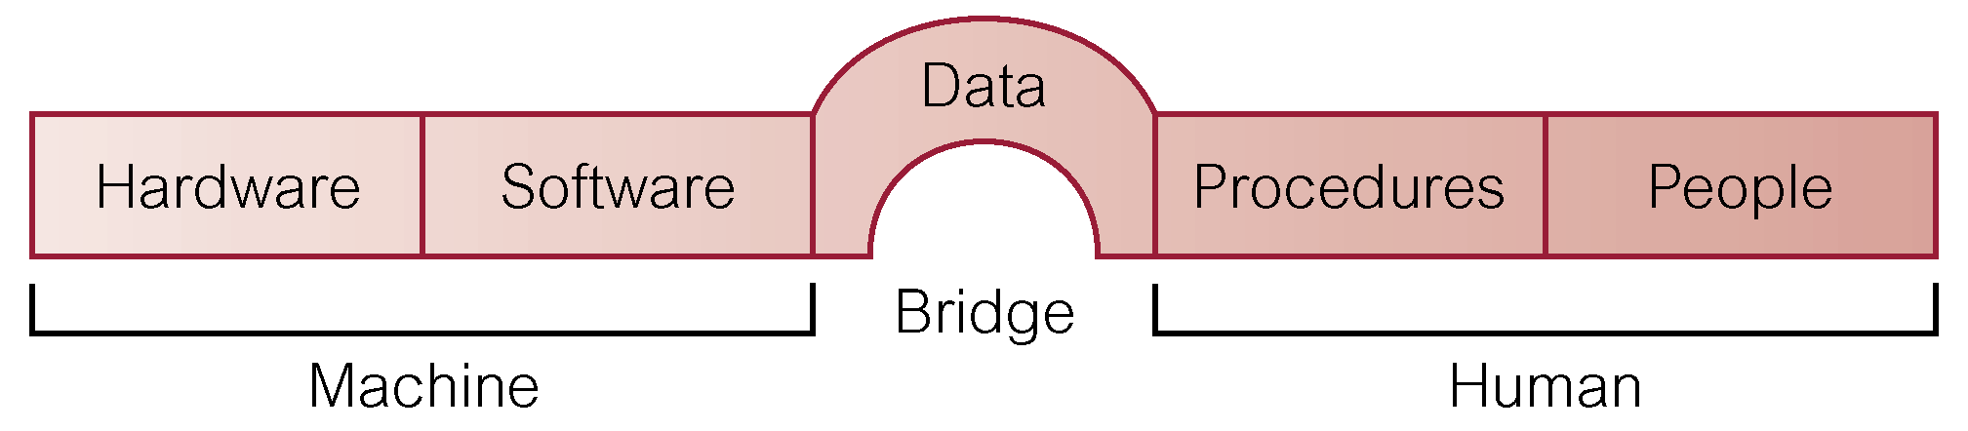
Components of DBMS Environment
MISD

Slide 47
Components of DBMS Environment.
  Hardware: refers to the physical parts of a computer and related devices. Can range from a PC to a network devices of computers.
  Software: collection of programs used by the computers within the database system. DBMS, operating system, network software.
  Procedures: Instructions and rules that should be applied to the design and use of the database and DBMS. These may consist instructions on how to:
    Log onto the DBMS, Start and Stop DBMS, make backup copies
MISD

Slide 48
Components of DBMS Environment
People: Users of the database system e.g. database designers, DBAs, application programmers, and end-users.
Data: Data acts the bridge between the machine and human components. The database contains both operational and meta data (data about data).
MISD

Slide 49
Roles/Users in the Database Environment
Data Administrator (DA): Responsible over the data policies in the organization. Does not need to be a technical person.
Data administrator's duties include:
  Database planning,
  Development and Maintenance of standards, policies
  Taking part in the conceptual design of the database
MISD

Slide 50
Roles/Users in the Database Environment
Database Administrator (DBA) also known as DBA’s Responsible for the management and control of the database. More technically oriented than the DA
Database administrator's duties include:
  Granting user authority to access the database.
  Specifying integrity constraints.
  Monitoring performance and responding to changes in requirements.
MISD

Slide 51
Roles/Users in the Database Environment
Database Designers ( Logical and Physical)
  Logical database designer: concerned with identifying data ( the attributes, entities, relationships between the data).
  Physical database designer: designs any security measures required on the data. Selecting specific storage structures,(Swap-space management) and access methods for data to achieve good.
MISD

Slide 52
Roles/ Users in the Database Environment
Application Programmers: Write programs for accessing and interacting with the database through DML calls such as data retrieval, data update, data insertion and data deletion.
End Users (naive and sophisticated): participate in data entry of data and manipulation.
  Naive Users: do not know any thing about the database e.g. checkout assistant at a local supermarket.
  Sophisticated users: have knowledge of how the database runs e.g. Systems administrator
MISD

Slide 53
Data types of field and field size
Before creating a database, you must know the data type of field and the field size. The field size specifies the max number of characters or amount of data that can be stored into the field.
What is a data type?
It is a feature in database which specifies that type of data to be held in a given field(stored).
MISD

Slide 54
Common data types fields
Text-Text or combinations of text and numbers, as well as numbers that don't require calculations, such as phone numbers. –Up to 255 characters
Memo-Lengthy text or combinations of text and numbers -Up to 65,535 characters.
AutoNumber-A unique sequential (incremented by 1) number or random number assigned by Microsoft Access whenever a new record is added to a table. AutoNumber fields can't be updated.
Yes/No-Yes and No values are fields that contain only one of two values (Yes/No, True/False, or On/Off).
MISD

Slide 55
Common data types fields
OLE Object-An object (such as a Microsoft Excel spreadsheet, a Microsoft Word document, graphics, sounds, or other binary data) linked to or embedded in a Microsoft Access table.
Date/Time-Date and time values for the years 100 through 9999.
Number-Numeric data used in mathematical calculations.
MISD

Slide 56
Common data types
Integer-It refers to a data type which represents some finite subset of the mathematical integers. An integer is specified in the program as a sequence of digits without spaces or thousands separators, optionally prefixed with + or –
Boolean-It is a data type having two values usually denoted TRUE or FALSE / Yes or No.
Character-It is a unit of data that corresponds to a unit, or symbol, such as in an alphabet written in form of a natural language.
Floating-point number-It describes a system for representing real numbers which supports a wide range of values.
MISD

Slide 57
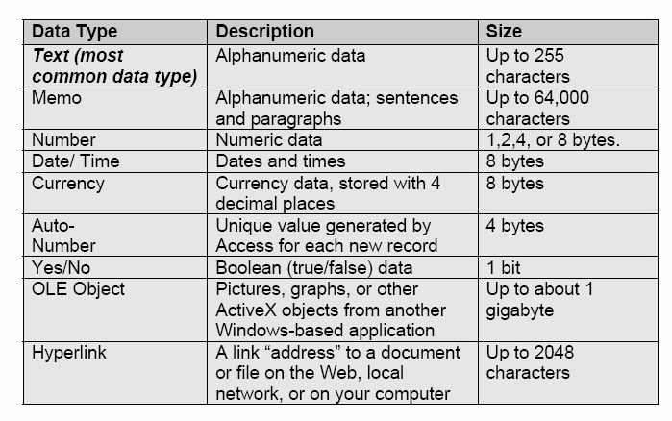
Summary of common Data Types
MISD

Slide 58
Basic Database Concepts
File /Table/Entity
A set of related records .
A database table is similar in appearance to a spreadsheet, in that data is stored in rows and columns in a spreadsheet while data is stored in fields and records in a database.
Field
A single item of data common to all records
Record
A collection of data about an individual item
An attribute
It is part of the description of the entity. Some of the attributes of a student include name, subject, class, age, sex etc.
MISD

Slide 59
Basic Database Concepts Cont…
Primary key- It is a field(combination of fields) whose value(s) uniquely identify a record in a table.
Relationship-Is an association between two entities.
Null values: Means that a field can be saved without any value.
Foreign key: It is a field(combination of fields) whose value(s) are related to a primary key in another table.
Data Definition Language(DDL): The language used to define objects in a database ie CREATE TABLE
Data Manipulation Language(DML): The language used to manipulate objects in a database ie INSERT, UPDATE, SELECT and DELETE.
MISD

Slide 60
Basic Database Concepts Cont…
Tables-In Access, data is stored in tables. A table is a set of columns and rows, with each column referred to as a field. Each value in a field represents a single type of data. Each row of a table is referred to as a record.
Queries-You use queries to retrieve specific data from your database and to answer questions about your data. For example, you can use a query to find the names of the employees in your database who live in a particular stat
Forms-Forms give you the ability to choose the format and arrangement of fields. You can use a form to enter, edit, and display data.
MISD

Slide 61
Basic Database Concepts Cont…
Reports-Reports organize or summarize your data so you can print it or view it onscreen. You often use reports when you want to analyze your data or present your data to others.
Macros-Macros give you the ability to automate tasks. You can use a macro to add functionality to a form, report, or control.
Modules-Like macros, modules give you the ability to automate tasks and add functionality to a form, report, or control. Macros are created by choosing from a list of macro actions, whereas modules are written in Visual Basic for Applications.
Database window: the window that appears when you open a database and that is the main control center for working with an open Access database.
Objects Bar: contains a set of controls each of which controls one of the six major object groups in an Access database: tables, queries, forms, reports, macros and modules.
Groups Bar : provides a way to organize database objects into groups and provides shortcuts to those objects to make them easily accessible.
MISD
Notes:
Basic Database Concepts Cont…
Datasheet view: shows a table’s contents as a datasheet in rows and columns.
Field selector (column selector) : located at the top of each column in a datasheet; clicking it selects the entire column.
Record selector (row selector): located to the left of a row in a datasheet; clicking it selects the entire row.
Current record symbol: a symbol that identifies the currently selected record.
Navigation buttons: located at the bottom of Datasheet view; provide a way to move vertically through the records.
Specific Record box: located between the two sets of navigation buttons in Datasheet view; displays the current record number.
Compacting: rearranges the data and objects in a database to make its size smaller.
TROPICAL HIGH SCHOOL ICT DEPARTMENT 2014

Slide 62
Database Design and Optimization
Database Design
  Process of defining the structure of a database.
  Includes defining tables, relationships, and constraints.
Database Optimization
  Enhancing database performance through indexing, query optimization, and normalization.
MISD

Slide 63
Database design
Database design is a crucial step in the development of a database system. It involves defining the structure that will be used to store and organize data efficiently.
A well-designed database is essential for ensuring data integrity, flexibility, and optimal performance.
Effective database design is an iterative process that involves collaboration with stakeholders, ongoing refinement, and adaptation to changing requirements. It aims to create a structure that facilitates efficient data storage, retrieval, and management while ensuring data integrity and security.
MISD

Slide 64
Steps in database design
1. Requirements Analysis:
  Understand the information needs of the organization or application.
  Identify data entities, relationships, and business rules.
2. Conceptual Design:
  Create a high-level conceptual model using techniques like Entity-Relationship Diagrams (ERD).
  Define entities, attributes, and relationships.
3. Normalization:
  Apply normalization techniques to minimize data redundancy and dependency.
  Ensure that the database structure is in compliance with normalization rules (1NF, 2NF, 3NF, etc.).
MISD

Slide 65
Steps in database design
4. Data Model Selection:
Choose an appropriate data model (e.g., relational, hierarchical, network) based on the requirements.
5. Logical Design:
Transform the conceptual model into a logical model using the chosen data model.
Define tables, fields, and relationships.
Normalize the data to eliminate redundancy.
6. Data Integrity:
Implement constraints to maintain data integrity (e.g., primary keys, foreign keys, unique constraints).
Enforce referential integrity to ensure consistency.
MISD

Slide 66
Steps in database design
7. Normalization Refinement:
  Further refine normalization based on the specific needs of the application.
8. Physical Design:
  Determine the storage structures and access mechanisms for optimal performance.
9. Denormalization (if necessary):
  Assess whether denormalization is needed to improve query performance.
10. Security and Access Control:
  Define roles and permissions to restrict access to sensitive data.
11. Documentation:
  Create comprehensive documentation detailing the database design, including entity-relationship diagrams, data dictionaries, and schema definitions.
MISD

Slide 67
Steps in database design
12. Testing and Validation:
  Test the database design to ensure it meets the functional and performance requirements.
  Validate data integrity and consistency.
13. Implementation:
  Create the database schema using Data Definition Language (DDL) statements.
  Populate the database with initial data.
14. Maintenance and Evolution:
  Monitor and maintain the database over time.
  Accommodate changes and updates to the database structure as the application evolves.
15. Backup and Recovery Planning:
  Develop strategies for regular backups and recovery procedures to safeguard data.
MISD

Slide 68
Database optimization
Database optimization is the process of fine-tuning a database system to improve its performance, responsiveness, and efficiency. It involves optimizing the structure, queries, and operations to ensure that the database can handle a large volume of data and user requests effectively.
Optimizing a database is an ongoing process that requires continuous monitoring, analysis, and adjustment based on changing usage patterns and requirements.
MISD

Slide 69
Key strategies to optimize database
1. Indexing
  Create indexes on columns frequently used in search conditions and join operations.
2. Query Optimization
  Optimize database queries to reduce execution time.
3. Normalization and Denormalization
  Strike a balance between normalization and denormalization based on the specific needs of the application.
4. Database Design Refinement
  Review and refine the database design to eliminate unnecessary complexity and improve efficiency.
5. Partitioning
  Partition large tables into smaller, more manageable pieces based on specific criteria (e.g., range, list, hash).
  Helps improve query performance and maintenance operations.
6. Caching
  Implement caching mechanisms to store frequently accessed data in memory.
MISD

Slide 70
Key strategies to optimize database
7. Concurrency Control:
  Optimize concurrency control mechanisms to manage simultaneous transactions efficiently.
10. Hardware Considerations:
  Ensure that the hardware infrastructure, including storage and memory, is appropriately sized for the database workload.
11. Regular Maintenance:
  Schedule regular database maintenance tasks, such as index rebuilding and statistics updating.
14. Load Balancing:
  Implement load balancing for distributed databases to evenly distribute the workload across multiple servers.
  Enhances scalability and availability.
15. Backup and Restore Optimization:
  Optimize backup and restore processes to minimize downtime and resource utilization.
MISD

Slide 71
Database Management System (DBMS)
Database Management System/Software – This is a program which allows you to create and manage an organized collection of related and structured information (a database).
Computer program that stores and manages information in a digital repository deployed on a server. This program lets users keep, sort, update, retrieve and modify their records in a single database.
MISD

Slide 72
Features of a (DBMS)
Data Structuring:
Every piece of information that you can add to your database will be organized in a kind of catalogue, so it will be easier for you to search and update your records later on.
Database Customization
Along with default and necessary elements (records, tables, or objects) that compose a database's structure, there can be created custom elements that meet specific needs of users.
Data Retrieval
Database management system accepts data input from users and stores it. Users can access the database later on to retrieve their records as a file, printed, or viewed on the screen.
MISD

Slide 73
Features of a (DBMS) Cont….
Query Languages: A typical DBMS makes it possible to use query languages for collecting, searching, sorting, modifying and other activities that help users manipulate their records in the database.
Multi-user Access
DBMS provides multiple users access to all types of information stored in one and the same data store. There is also a security feature that prevents some users from viewing and/or modifying certain data types.
Data Integrity
All information in a database is accessible by several or more users but only one user can change the same piece of data at a time. This capability lets prevent database corruptions and failure.
Metadata
DBMS database management software provides a metadata library (or a data dictionary) that describes how the database is organized and what elements (objects, related files, records, etc.) compose its structure.
MISD

Slide 74
Database Management System (DBMS)
Examples of Database management software include:
Lotus Approach, Microsoft Access, OpenOffice.org Base, Corel Paradox , Oracle ,Structured Query Language(SQL), MySQL
Examples of Databases:
School Management System
Hospital Management System
Inventory Management System
Bill Management System
Reservation Management System
Weather forecast Management System
MISD

Slide 75
Information Systems Architecture (ISA)
This is the structure that supports the operation of an information system.
Components
  Hardware
  Software
  Data
  People
  Procedures
Types:
  Enterprise Architecture: Aligns information systems with business strategy.
  Technology Architecture: Focuses on technology infrastructure.
  Data Architecture: Deals with data storage, retrieval, and management.
MISD

Slide 76
Chapter Review Questions
What are the challenges/Limitations of the manual filing system?
What are the differences between the manual filing system, file-based system and the database approach?
Give examples of single user and multiuser DBMS?
Of what importance is a database in the management of data?
What makes the database approach better than its predecessors in data management?
MISD

